Slide 1
Big Data Analysis for UBER Reviews
CPSC 531-03 ADVANCED DATABSE MANAGEMENT
Prepared By:-
Vaibhav Monpara
Vasukumar Lakhani
Nishantkumar Asodariya

Slide 2
CONTENTS
Why Analysis?
APPORACH
About the dataset
Data Cleaning
Logistic Regression
IMPLEMENTATION
UPCOMING PLANs

Slide 3
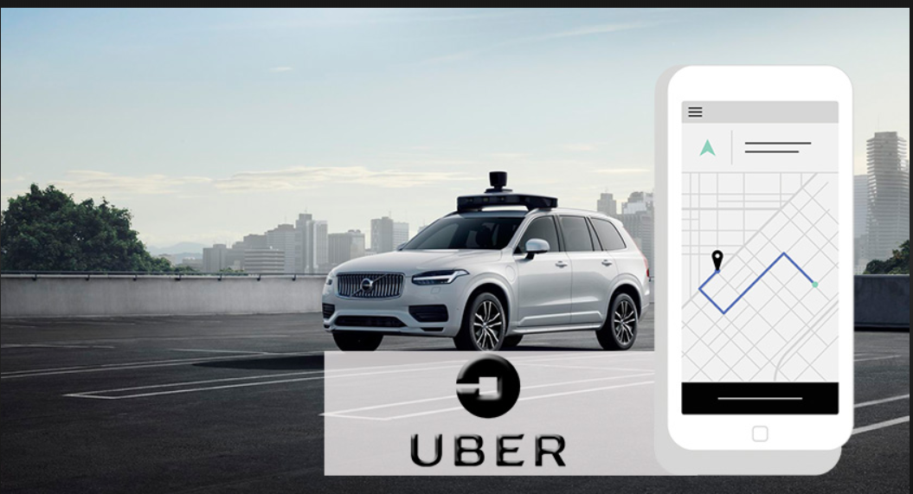
Our project talks about analyzing the reviews and feedbacks from the customer.
It would be a great help for the company to know the feedback or the experience of their customers which eventually helps them in knowing the flaws and to work on specific feature to improve.

Slide 4
Approach

Slide 5
About the Dataset
We chose the UBER TEXT REVIEWS dataset openly available on website called Towards-data-Science https://towardsdatascience.com/uber-reviews-text-analysis-11613675046d
There are 3 columns in this dataset.
Ride review
Ride rating (on a scale of 1 to 5)
Sentiment (binary)
If the rating is 1 or 2 implies that the sentiment is 0.
If the rating is 3, 4 or 5 implies that the sentiment is 1.

Slide 6
Cleaning the Data
The first VITAL task is to clean the data WHICH HAS BEEN PROVIDED BY UBER.
A clean dataset PROVIDES improved prediction and accuracy.
We start by removing the rows with ride ratings of 3. With a compromised rating OF 3 THE accuracy decreases IT serves no useful purpose for us.

Slide 7
Cleaning the Data
The next step is to compile a list of frequently used words, remove them from the review column, and save them in a new column for later use.
Tokenization is also used on the cleaned column. Each word in the text receives a token as a result.

Slide 8
Applying Logistic Regression..
To apply any model, We first divide the data into Training data and Testing data
Usually, 70% of the data is the training data and 30% is the testing data.
The training data is used to train the model and the model is tested using the testing data.
We declare the features using the CountVectorizer function
We apply the Logistic Regression model and fit it with the training data.
Once the data is trained, we test it by giving the testing data as input.

Slide 9
IMPLEMENTATION

Slide 10
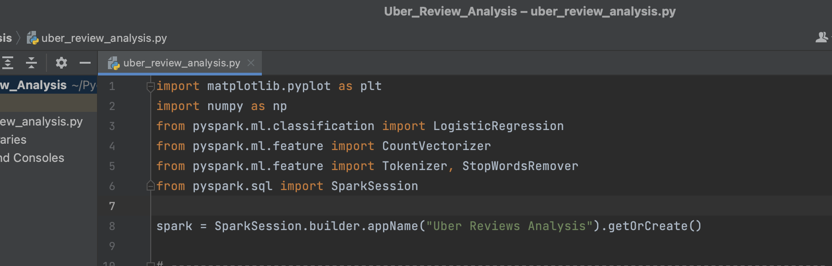
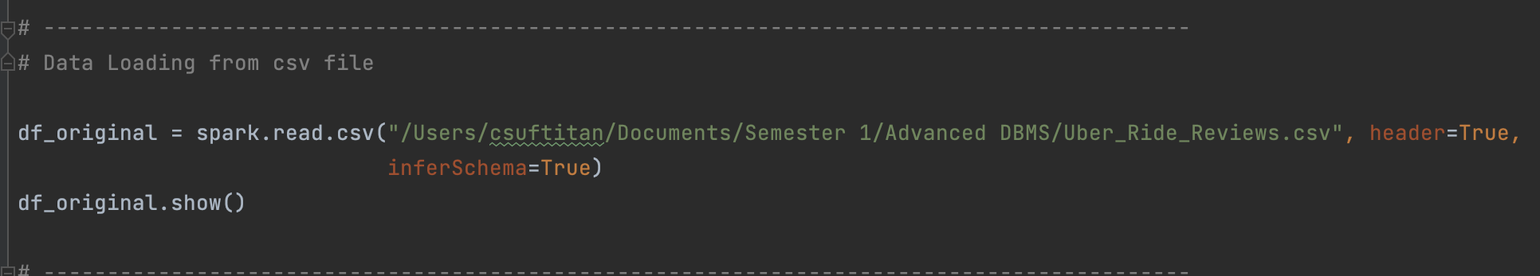
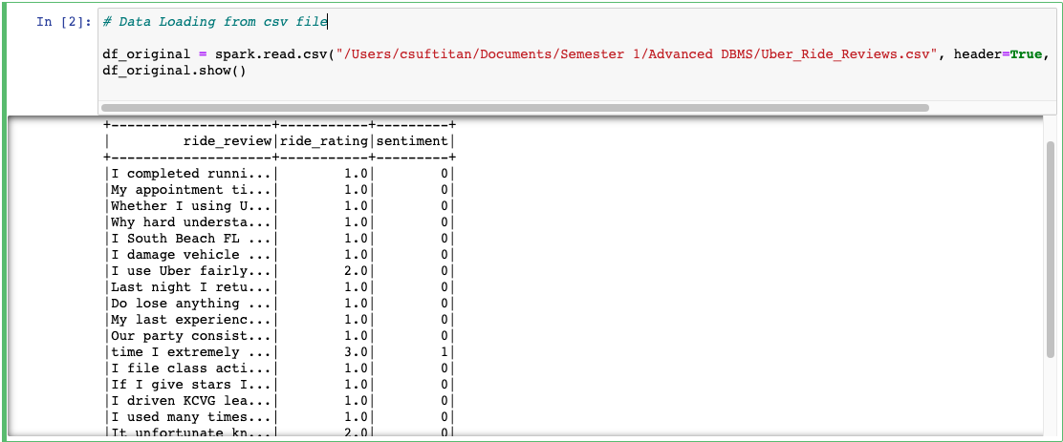
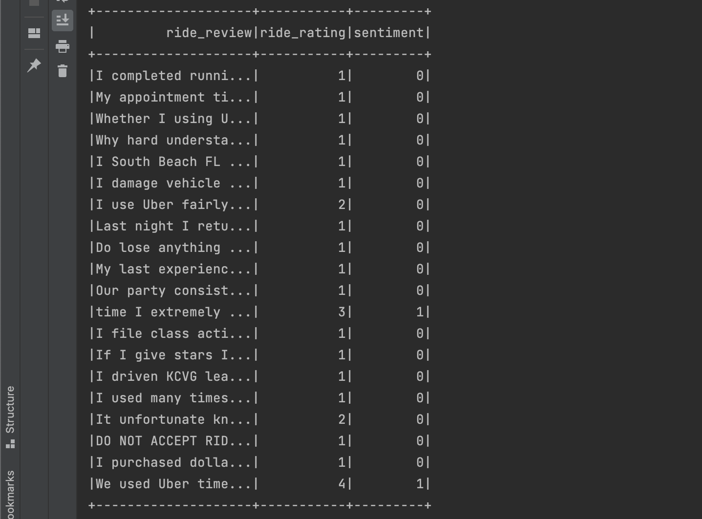
Snippets of code
Importing the required libraries from pyspark.
Loading the data from a csv file.

Slide 11
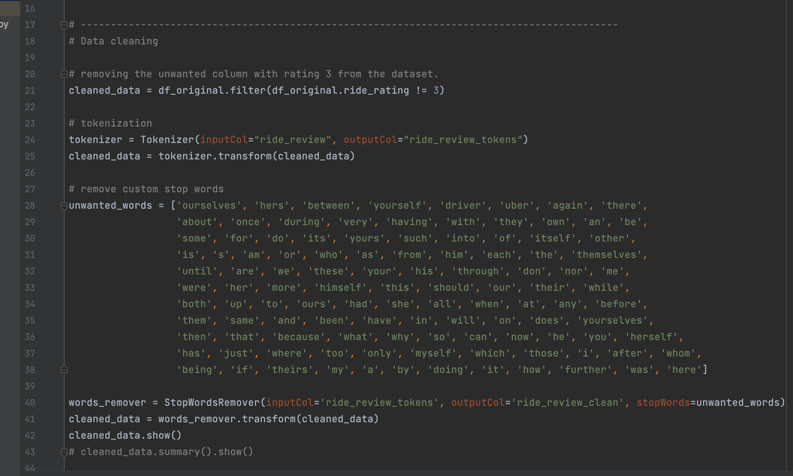
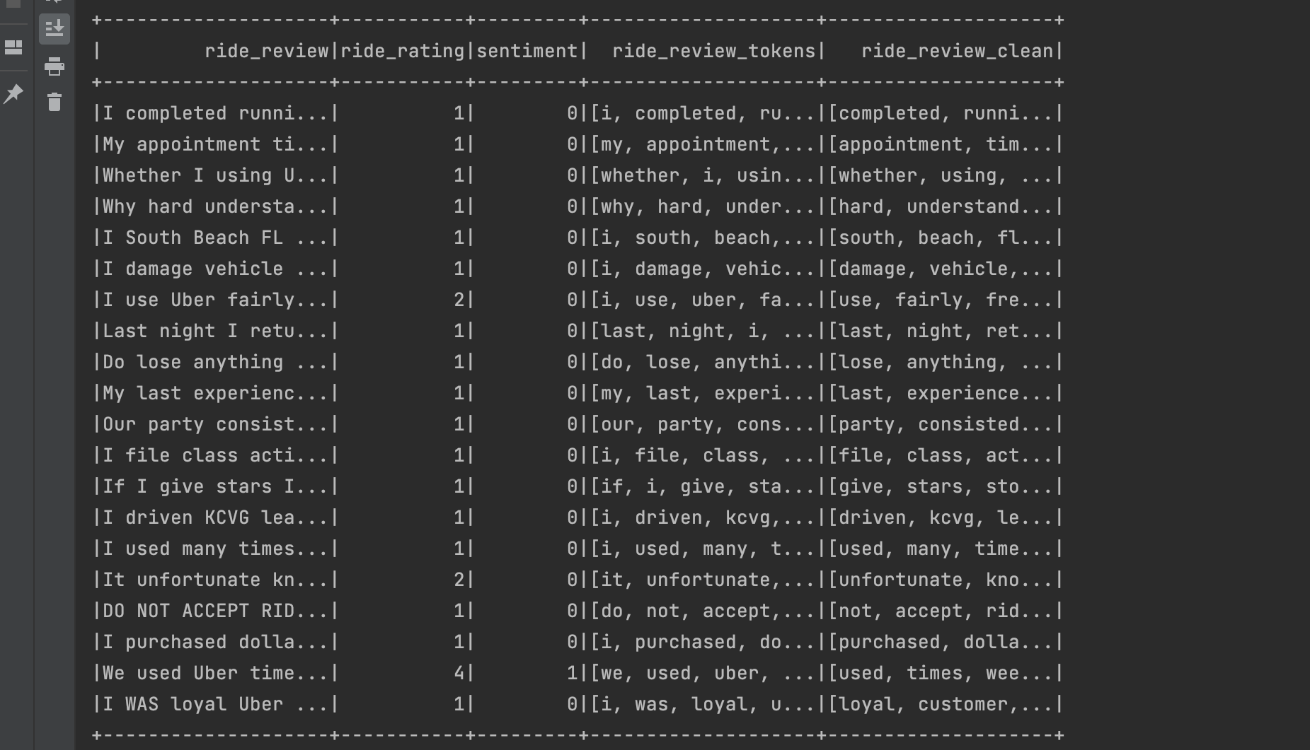
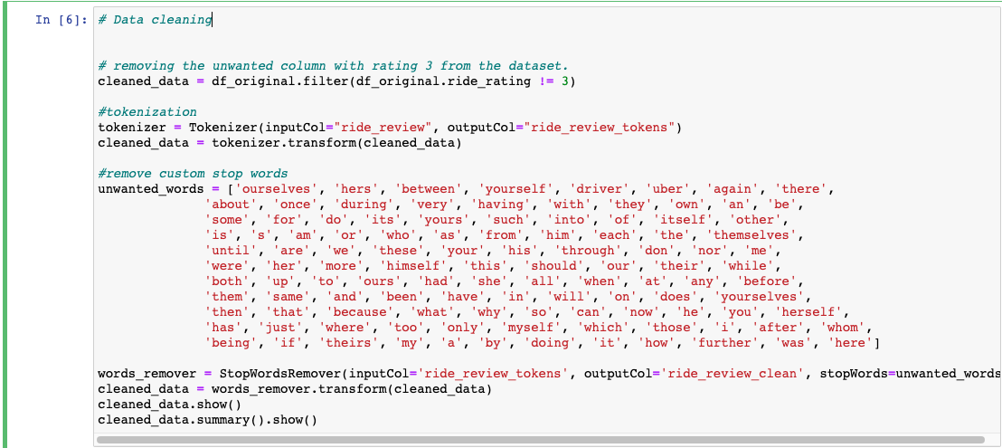
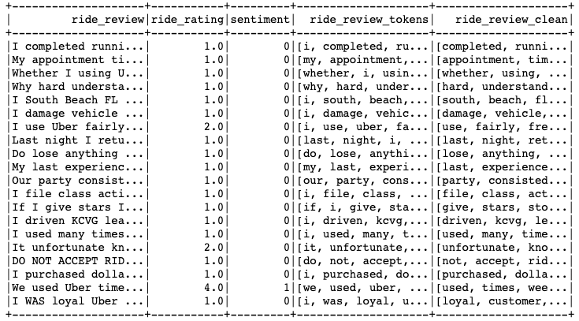
DATA CLEANING & OUTPUTS

Slide 12
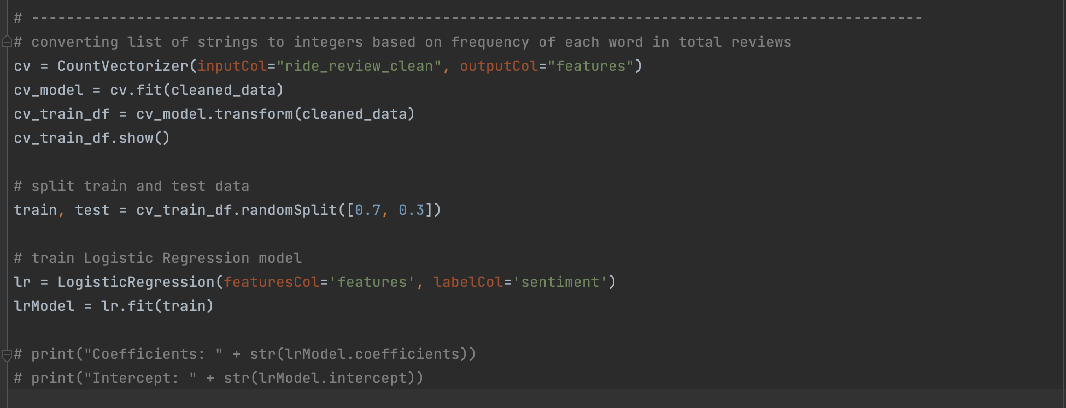
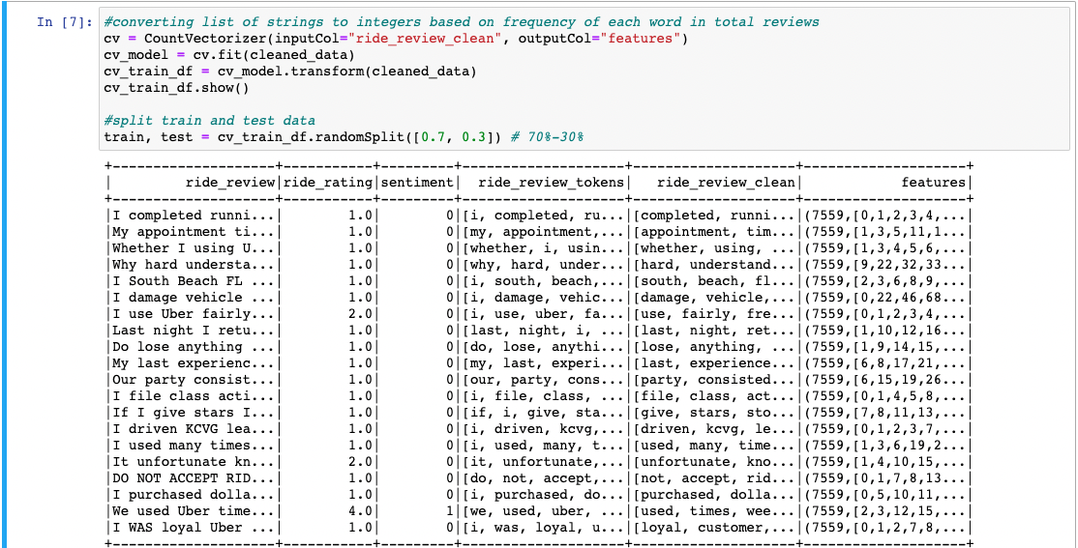
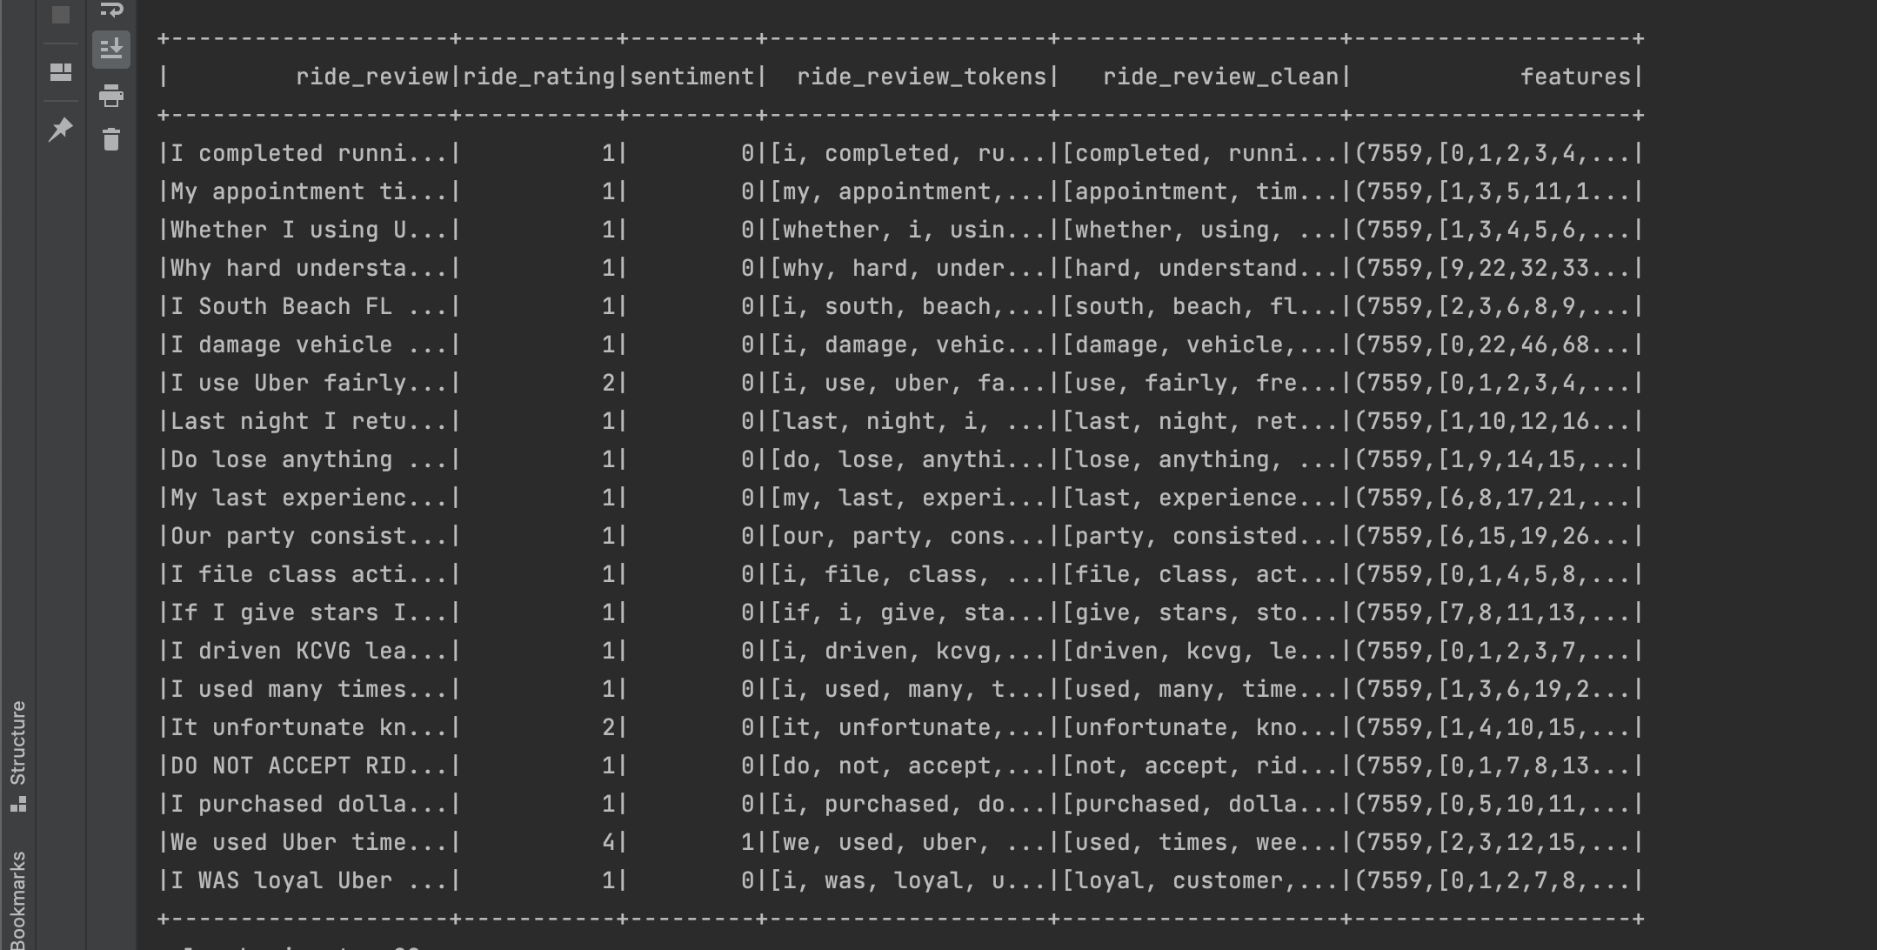
Converting list of string to list of integers using CountVectorizer. into numbers based on the frequency of their occurrence.

Slide 13
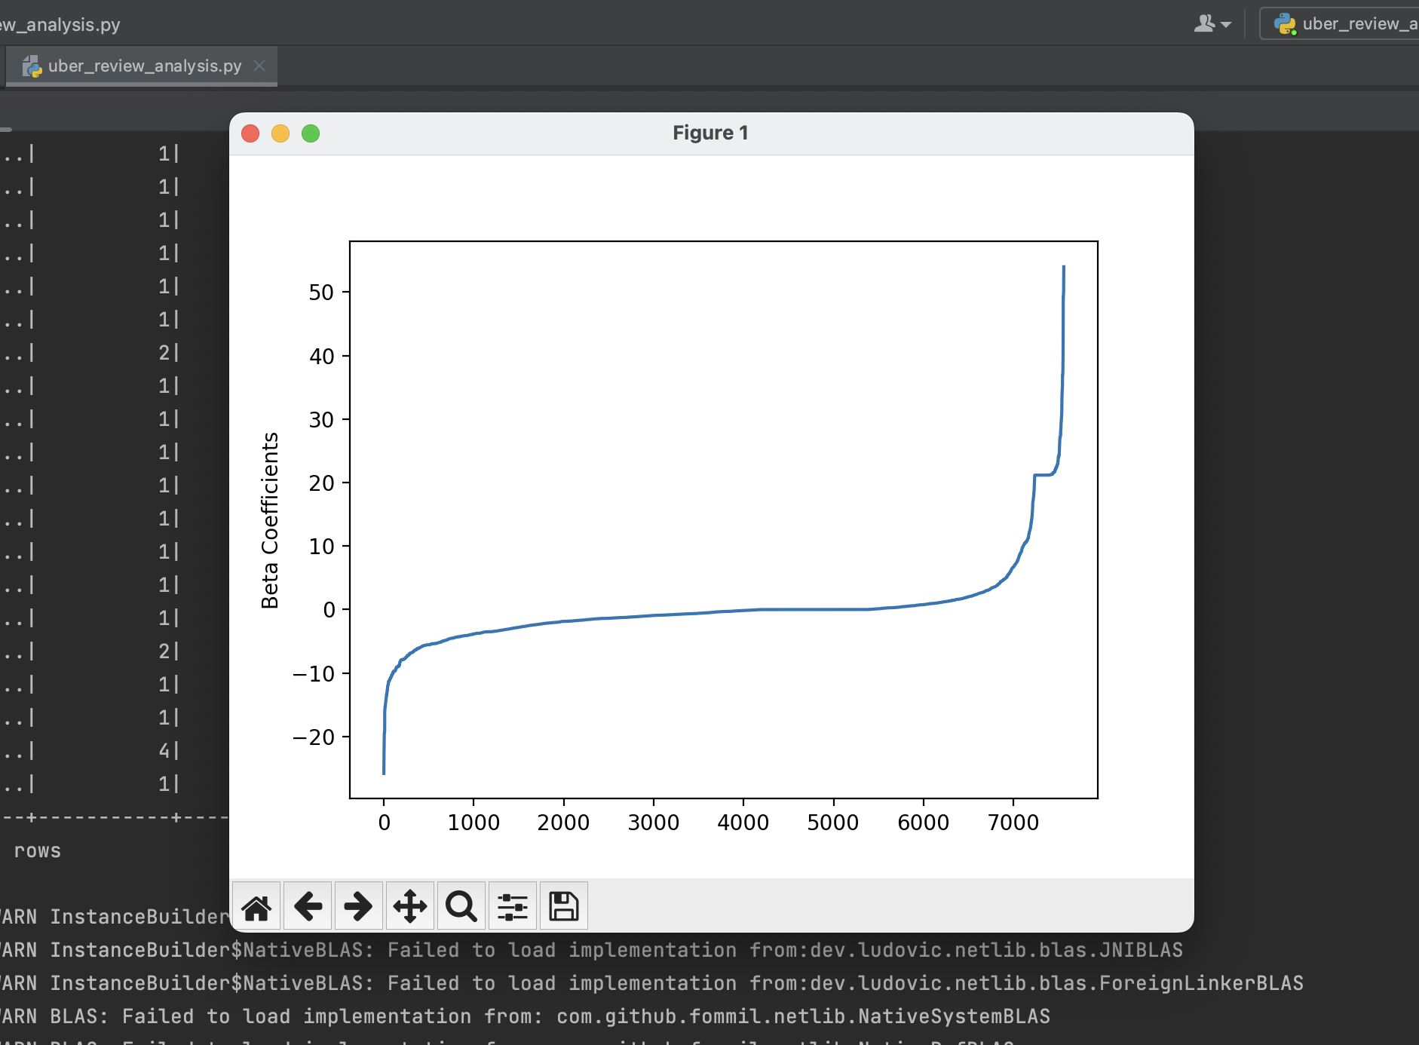
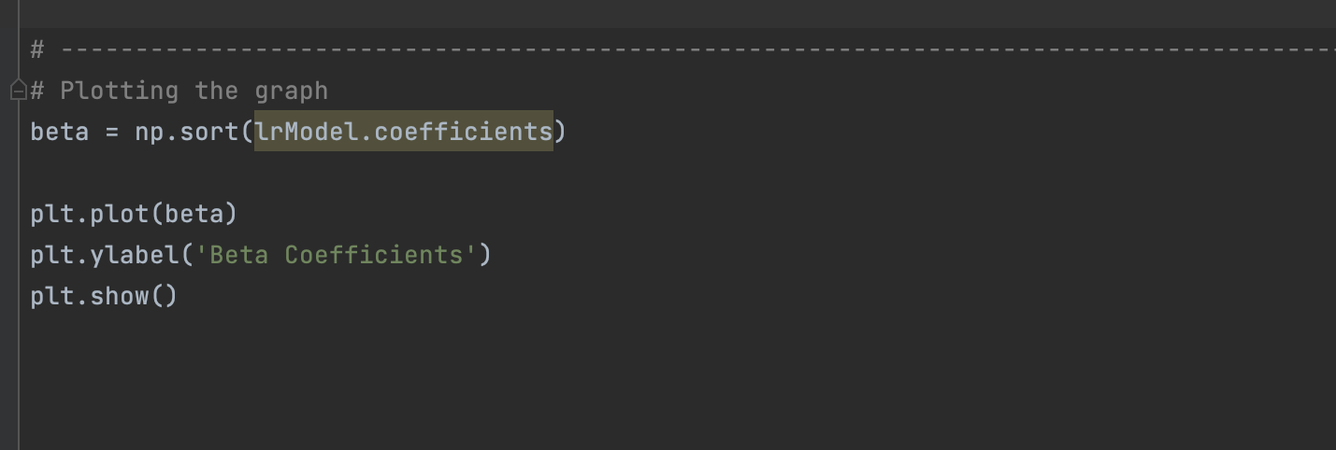
Graph plot using matplotlib

Slide 14
UpComing plans…
Try of test with larger Dataset.
Trying to complete the Prediction code using LR model
Working on reviews such as “The ride was not good at all”. Here, good falls under the positive review category. However, as it is preceded by a negative word ‘not’ changes the meaning totally.

Slide 15


